Slide 1
Digital Humanities and Digital Knowledge
Introductory Activities 2019-20
Tools for Developers
Tuesday, October 10th
Francesco Poggi
francesco.poggi5@unibo.it
Department of Computer Science and Engineering
University of Bologna - Italy

Slide 2
Outline
Version Control Systems (VCSs)*
Git (basic concepts and workflow)
GitHub
Handson
* from the Pro Git book (Chacon & Straub, 2014) - under CC BY-NC-SA 3.0 license
Notes:
‹#›

Slide 3
What is version control?
Version control is a system that records changes to a file or set of files over time so that you can recall specific versions later.
A Version Control System (VCS) allows you to:
revert selected files (or an entire project) back to a previous state
compare changes over time
see who last modified something that might be causing a problem, who introduced an issue and when
recover files with very little overhead
and more...

Slide 4
Problem
What is “version control”, and why should you care? Version control is a system that records changes to a file or set of files over time so that you can recall specific versions later. Software source code are files that are often version controlled, though in reality you can do this with nearly any type of file on a computer.
If you are a graphic or web designer and want to keep every version of an image or layout (which you would most certainly want to), a Version Control System (VCS) is a very wise thing to use. It allows you to revert selected files back to a previous state, revert the entire project back to a previous state, compare changes over time, see who last modified something that might be causing a problem, who introduced an issue and when, and more. Using a VCS also generally means that if you screw things up or lose files, you can easily recover. In addition, you get all this for very little overhead.

Slide 5


History pt.1: Local Version Control Systems
Naïf version control method: copy files into another directory
simple...
...but incredibly error prone
⇒ programmers developed Local VCSs:
a simple local database that kept all the changes to files under revision control
re-create what any file looked like at any point in time
Local ⇒ No collaboration
E.g.: Revision Control System (RCS).

Slide 6
History pt.2: Centralized Version Control Systems
The next major issue: how to collaborate with developers on other systems?
⇒ centralized Version Control Systems (CVCSs):
a single server that contains all the versioned files
clients that check out files from that central place
E.g.: Concurrent Versions System (CVS), Subversion, and Perforce

Slide 7
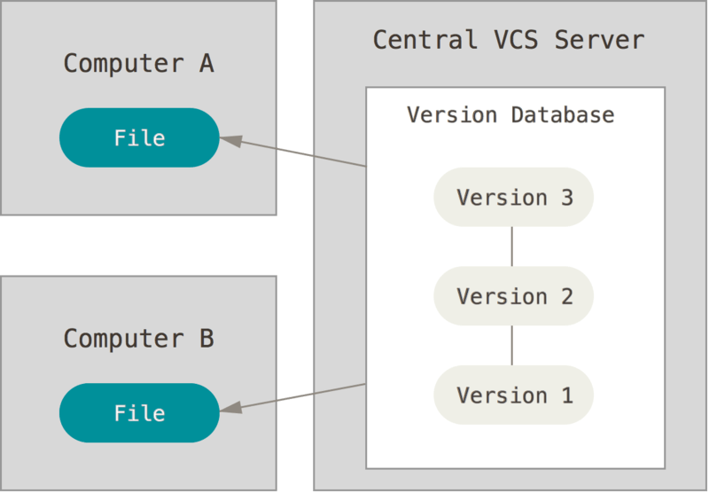
History pt.2: Centralized Version Control Systems
Advantages (compared to LVCSs):
collaboration
users and permissions
Main problem:
single point of failure
Since the entire history of the project is in a single place, you risk losing everything...

Slide 8
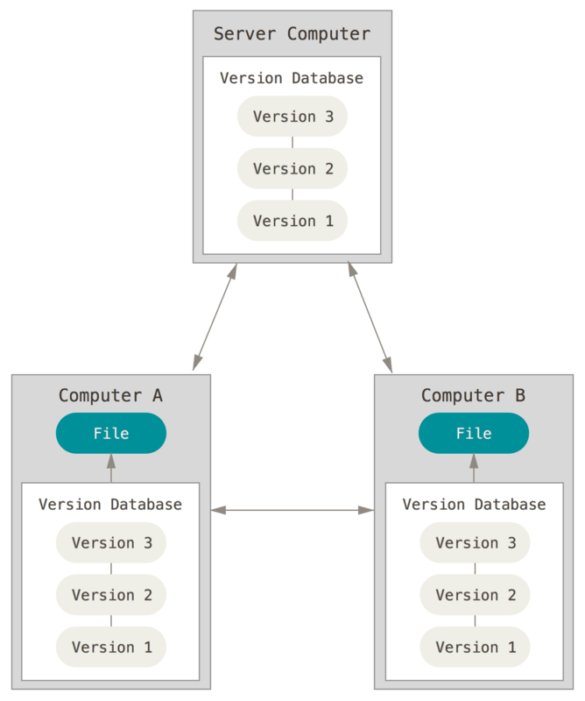
History pt.3: Distributed Version Control Systems
Distributed Version Control Systems (DVCSs):
each client fully mirrors the repository, including its full history
If any server dies, any of the client repositories can be copied back up to the server to restore it
E.g.: Git, Mercurial, Bazaar or Darcs

Slide 9
A Short History of Git
Linux is an open source software project of fairly large scope.
1991-2002: changes to the software were passed around as archived files.
In 2002, the Linux project began using a proprietary DVCS called BitKeeper.
In 2005, the BitKeeper’s free-of-charge status was revoked.
Linus Torvalds (the creator of Linux) started the development of a new VCS: Git.

Slide 10
Git: Goals
Git’s main goals:
Speed
Simple design
Strong support for non-linear development (thousands of parallel branches)
Fully distributed
Able to handle large projects like the Linux kernel efficiently (speed and data size)

Slide 11
Basic Concepts: Snapshots
The major difference between Git and other VCSs is the way Git thinks about its data.
Conceptually, most other systems store information as a list of file-based changes:
a set of files
the changes made to each file over time (i.e. deltas)

Slide 12
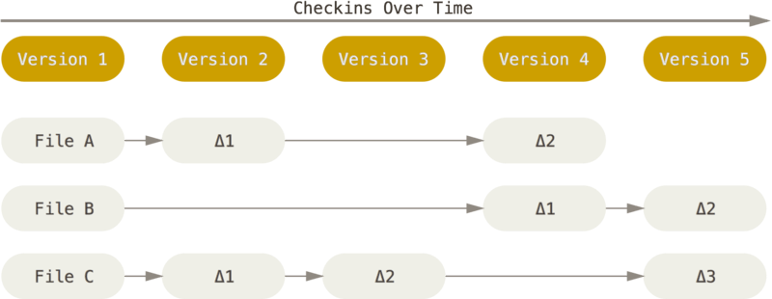
Basic Concepts: Snapshots
Delta-based version control system

Slide 13
Basic Concepts: Snapshots
Instead, Git thinks of its data like a series of snapshots of a miniature filesystem (i.e. your files and directories).
Every time you save the state of your project, Git takes a picture of what all your files look like at that moment and stores a reference to that snapshot.
Snapshots are pictures of how your files looks like at a given point in time.
To be efficient, if files have not changed, Git stores a link to the previous identical file it has already stored.

Slide 14
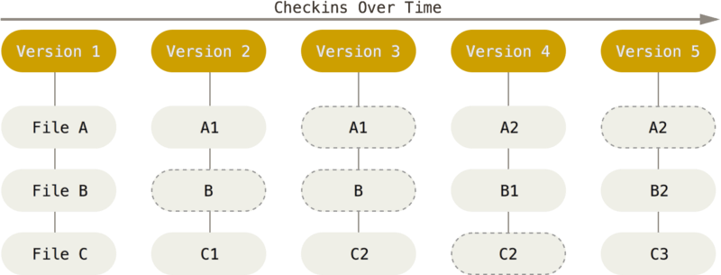
Basic Concepts: Snapshots
Git thinks about its data more like a stream of snapshots.
new file
new version
link to previous file

Slide 15
Basic Concepts: Commit
Commit: the act of creating a snapshot
Can be a noun or a verb:
“I commited code”
“I just made a new commit”
Essentially, a project is made up of a bunch of commits.

Slide 16
Basic Concepts: Commit
Commits contain three pieces of information:
information about how the files changed from previously
a reference to the commit that came before it
called the “parent commit”
a hash code name (see next)

Slide 17
Basic Concepts: Integrity
A checksum is a small-sized datum derived from a block of digital data for the purpose of detecting errors which may have been introduced during its transmission or storage.
INPUT
OUTPUT
YES!
File 1
CHECKER
(i.e. an algorithm that verifies data integrity)
NO!
checksum
24b9da6552252987aa493

Slide 18
Basic Concepts: Integrity
The checksum mechanism (i.e. algorithm) used by Git is called a SHA-1 hash.
Git stores everything in its database not by file name but by the hash value of its contents
hash names are used as identifiers
A 40-character string composed of hexadecimal characters (0–9 and a–f) and calculated based on the contents of a file or directory structure in Git.
File 1
SHA-1 hash
24b9da6552252987aa493b52f8696cd6d3b00373

Slide 19
Basic Concepts: Repositories
Repository (often shortened to “repo”):
A collection of all the files and the history of those files
consists of all your commits
the place where all your hard work is stored

Slide 20
Basic Concepts: Repositories
Repositories:
Can live on a local machine or on a remote server (e.g. GitHub)
The act of copying a repository from a remote server is called cloning
Cloning from a remote server allows team to work together
The process of downloading commits that don’t exist on your machine from a remote repository is called pulling changes
The process of adding your local changes to the remote repository is called pushing changes

Slide 21
Basic Concepts: Branches
All commits in Git live on some branch
But there can be many, many branches
The main branch in a project is called the master branch (doesn’t have to be called master, but almost always is!)
Branching means you diverge from the main line of development (master) and continue to do work without messing with that main line.

Slide 22
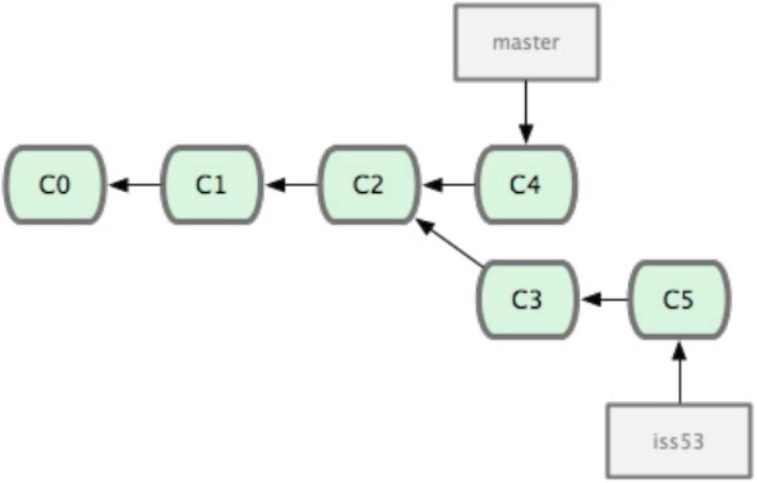
Basic Concepts: Branches
Branching off of the master branch

Slide 23
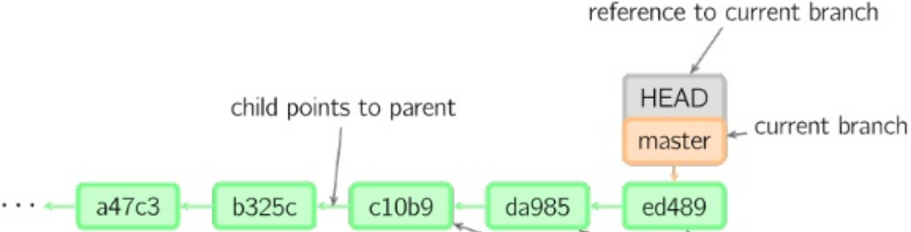
Basic Concepts: HEAD
So, what does a typical project look like?
A bunch of commits linked together that live on some branch, contained in a repository
What it is HEAD?
A reference to the most recent commit in the current branch (you can think of the HEAD as the "current branch")

Slide 24
Basic Concepts: the Three States
Git has three main states that your files can reside in:
Committed means that the data is safely stored in your local database.
Modified means that you have changed the file but have not committed it to your database yet.
Staged means that you have marked a modified file in its current version to go into your next commit snapshot.

Slide 25
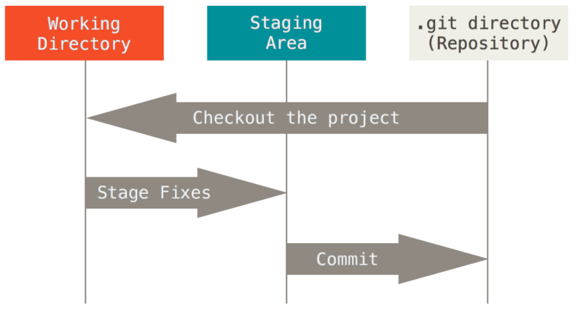
Basic Concepts: Main Project Sections
The three main sections of a Git project are:
.git directory: where Git stores the project metadata and object database.
Working directory: contains files and directory ready to be used or modified.
Staging area: a file storing information about what will go into your next commit. Its technical name in Git parlance is the “index”.

Slide 26
Basic Concepts: Basic Git Workflow
The basic Git workflow goes something like this:
you modify files in your working directory.
you selectively stage just those changes you want to be part of your next commit, which adds only those changes to the staging area.
you do a commit, which takes the files as they are in the staging area and stores that snapshot permanently to your Git directory.

Slide 27
Git: the Command Line
There are two ways to use Git:
the original command-line tools
many graphical user interfaces exist, with varying capabilities
We’ll start analyzing the command line because:
it implements all Git commands (while most GUIs implement a partial subset of Git functionality)
if you know the command-line version, you can also figure out how to run the GUI version (while the opposite is not true)
all Git users will have the command-line tools installed and available (while graphical clients are optional)
Then we’ll use the web interface provided by GitHub.

Slide 28
Git: Syntax and Use
git [options] <command> [<args>]
Example:
$ git --help
usage: git [--version] [--exec-path[=<path>]] [--html-path] [--man-path] [--info-path] [-p|--paginate|--no-pager] [--no-replace-objects] [--bare] [--git-dir=<path>] [--work-tree=<path>] [--namespace=<name>] [-c name=value] [--help] <command> [<args>]
The most commonly used git commands are:
add Add file contents to the index
branch List, create, or delete branches
checkout Checkout a branch or paths to the working tree
clone Clone a repository into a new directory
commit Record changes to the repository
diff Show changes between commits, commit and working tree, etc
fetch Download objects and refs from another repository
... ...
See 'git help <command>' for more information on a specific command.

Slide 29
Getting a Git Repository
You typically obtain a Git repository in one of two ways:
you can take a local directory that is currently not under version control, and turn it into a Git repository, or
you can clone an existing Git repository from elsewhere.
In either case, you end up with a Git repository on your local machine, ready for work.

Slide 30
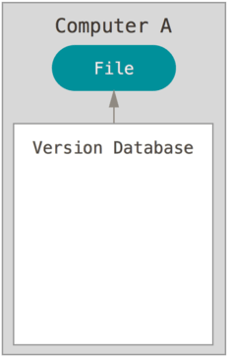
1. Initializing a Repository in an Existing Directory
Go to the project directory that you want to start controlling it with Git:
and initialize a new local repository (i.e. set up all the tools Git needs to begin tracking changes made to the project):
$ cd /home/user/my_project
$ git init
This command creates a new subdirectory named .git (i.e. the .git directory).
At this point, nothing in your project is tracked yet

Slide 31
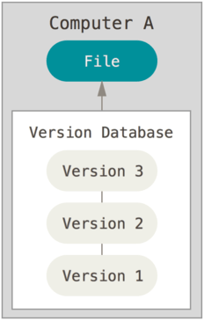
1. Initializing a Repository in an Existing Directory
To start version-controlling files, you should begin tracking those files and do an initial commit.
You can accomplish that with a few git add commands that specify the files you want to track, followed by a git commit:
$ git add file1 file2 file3
$ git add directory1/*
$ git commit -m 'initial project version'
Now you have a local project under version control.

Slide 32
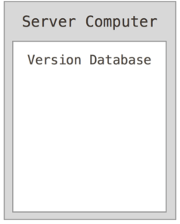
1. Adding Remote Repositories
To start collaborating, you have to:
create a new remote repository (empty)

Slide 33
1. Adding Remote Repositories
To start collaborating, you have to:
add a new remote repository (empty)
“link” the local repository to the remote repository.
Remote repositories are versions of your project that are hosted on the Internet or network somewhere.
To add a new remote Git repository you must specify a shortname and a url:
origin: is the default name Git gives to the server you cloned from.
$ git remote -u add <repo-shortname> <repo-url>

Slide 34
1. Adding Remote Repositories
Example:
Note: origin is the default name Git gives to the server you cloned from.
$ git push -u origin master
Username for 'https://github.com': fpoggi
Password for 'https://fpoggi@github.com':
remote:
remote: Create a pull request for 'master' on GitHub by visiting:
remote: https://github.com/fpoggi/dhdk-empty/pull/new/master
remote:
To https://github.com/fpoggi/dhdk-empty.git
* [new branch] master -> master
Branch master set up to track remote branch master from origin.

Slide 35
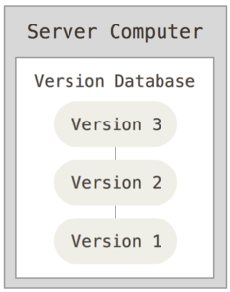
1. Adding Remote Repositories
Now we have the local repository and the remote repository initialized and “linked”
At any time, it si possible to check remotes URLs and shortnames:
$ git remote -v
origin https://github.com/fpoggi/dhdk-empty.git (fetch)
origin https://github.com/fpoggi/dhdk-empty.git (push)

Slide 36
2. Cloning an Existing Repository
git clone is the command to get a copy of an existing Git repository (e.g. a project you’d like to contribute to ):
a working copy is received (full copy of nearly all data that the server has).
every version of every file for the project history is pulled down by default
E.g.: cloning the official Mozilla Firefox code base:
Note: Git has a number of different transfer protocols you can use. The previous example uses the https protocol. Alternatives are git and ssh (e.g. user@server:path/to/repo.git)
$ git clone https://github.com/mozilla/gecko-dev

Slide 37
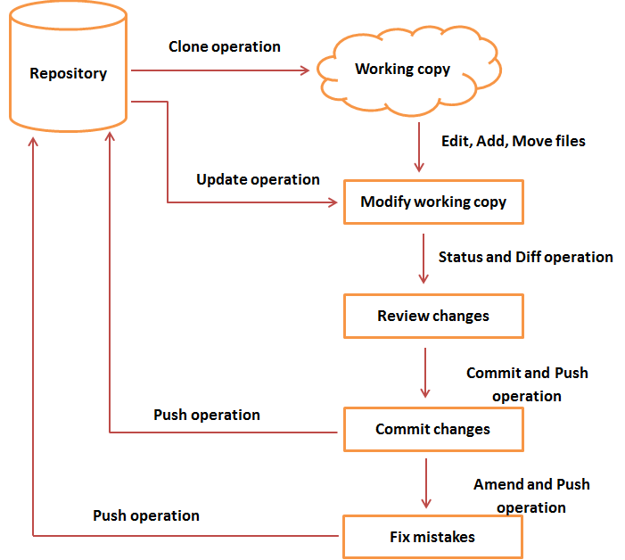
Basic Concepts: General Git Workflow
REMOTE
LOCAL
General workflow is as follows:
clone the Git repository as a working copy
modify the working copy by adding/editing files
update the working copy by taking other developer's changes
review the changes before commit
commit changes. If everything is fine, then you push the changes to the repository
After committing, if you realize something is wrong, correct (fix) the last commit and push the changes to the repository

Slide 38
1. The add Command
Use the add command to:
begin tracking a new file (e.g. README.txt)
modify an existing file - already under revision control (e.g. the red line in file1.txt)
Before proceed, you can check the project status
README.txt
Hello world!
Have a nice day!
file1.txt
First line.
This is a new line
$ git status
On branch master
Untracked files:
(use "git add <file>..." to include in what will be committed)
README.txt
Changes not staged for commit:
(use "git add <file>..." to update what will be committed)
(use "git checkout -- <file>..." to discard changes in working directory)
modified: file1.txt
no changes added to commit (use "git add" and/or "git commit -a")

Slide 39
1. The add Command
Now you can add both files to the staging area:
and then check the project status:
README.txt
Hello world!
Have a nice day!
$ git add README.txt file1.txt
On branch master
Untracked files:
(use "git add <file>..." to include in what will be committed)
README.txt
Changes not staged for commit:
(use "git add <file>..." to update what will be committed)
(use "git checkout -- <file>..." to discard changes in working directory)
modified: file1.txt
no changes added to commit (use "git add" and/or "git commit -a")
file1.txt
First line.
This is a new line
$ git status
On branch master
Changes to be committed:
(use "git reset HEAD <file>..." to unstage)
new file: README.txt
modified: file1.txt

Slide 40
The commit Command
Now that your staging area is set up the way you want it, you can commit your changes (i.e. put them into the Git database):
Git also provides a simple shortcut to skip the staging area. Adding the -a option to the commit command makes Git automatically stage every file that is already tracked before doing the commit, letting you skip the git add part:
$ git commit -m "Phase two - dhdk"
[master 463dc4f] Phase two - dhdk
2 files changed, 2 insertions(+)
create mode 100644 README.txt
$ git commit -a -m 'added new benchmarks'
[master 83e38c7] added new benchmarks
1 file changed, 5 insertions(+), 0 deletions(-)

Slide 41
The mv Command
If you rename a file in Git, no metadata is stored in Git that tells it you renamed the file.
To rename (or move) a file in Git, you have to explicitly inform Git:
However, this is equivalent to running something like this:
Remember that also in this case changes have to be committed.
$ git mv README.txt README
$ git status
On branch master
Your branch is up-to-date with 'origin/master'.
Changes to be committed:
(use "git reset HEAD <file>..." to unstage)
renamed: README.txt -> README
$ mv README.txt README
$ git rm README.txt
$ git add README

Slide 42
The rm Command
To remove a file from Git, you have to remove it from your tracked files (i.e. from your staging area) and then commit.
The rm command does that, and also removes the file from your working directory.
Remember that also in this case changes have to be committed.
$ git rm fileX.txt
$ git status
On branch master
Your branch is up-to-date with 'origin/master'.
Changes to be committed:
(use "git reset HEAD <file>..." to unstage)
deleted: fileX.txt

Slide 43
The pull Command
The pull command is used to perform two operations in one single step:
get data from your remote projects (fetch)
then automatically merge the remote branch into your current branch.
which is equivalent to the following two commands
$ git pull
$ git fetch origin HEAD
$ git merge HEAD

Slide 44
The push Command
The push <remote> <branch> to push your master branch to your server:
This command works only if you cloned from a server to which you have write access and if nobody has pushed in the meantime, otherwise the push will be rejected.
In this case, you’ll have to fetch their work first and incorporate (merge) it into yours before you’ll be allowed to push.
$ git push origin master

Slide 45
The diff Command
The diff command is usually used to answer two different questions:
What have you staged that you are about to commit?
What have you changed but not yet staged?
$ git diff
diff --git a/myfile.csv b/myfile.csv
index 7898192..be5afde 100644
--- a/myfile.csv
+++ b/myfile.csv
@@ -1 +1,3 @@
a
+Added the second line
+And also the thid line
$ git diff --staged
diff --git a/myfile.csv b/myfile.csv
new file mode 100644
index 0000000..7898192
--- /dev/null
+++ b/myfile.csv
@@ -0,0 +1 @@
+This is the first line

Slide 46
The merge Command
Merging is Git's way of putting a forked history back together again.
The git merge command lets you take the independent lines of development created by git branch and integrate them into a single branch.
Two main cases:
Fast Forward Merge
3-way merge

Slide 47
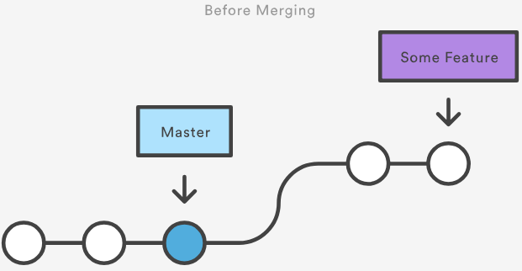
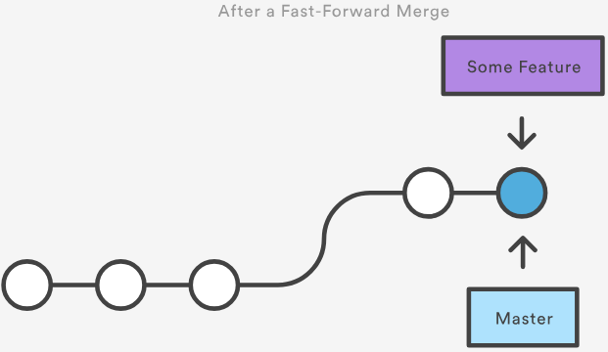
The merge Command
A fast-forward merge can occur when there is a linear path from the current branch tip to the target branch.
Solution: move (i.e., “fast forward”) the current branch tip up to the target branch tip.

Slide 48
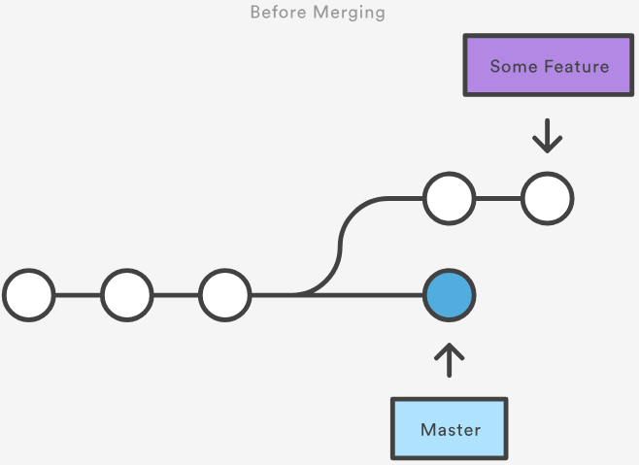
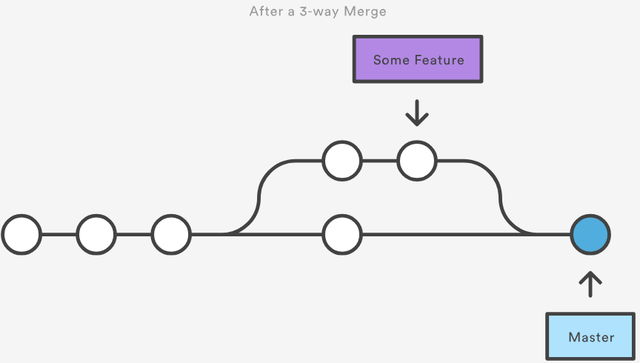
The merge Command
A fast-forward merge is not possible if the branches have diverged.
When there is not a linear path to the target branch, Git has no choice but to combine them via a 3-way merge.
3-way merges use a dedicated commit to tie together the two histories.

Slide 49
GitHub
What is GitHub?
https://github.com/
founded in 2008
one of the largest web-based git repository hosting services (i.e. remote repositories)
allows for code collaboration with anyone online
add functionality on top of git:
UI, documentation, bug tracking, feature requests, pull requests, etc.
also has an Enterprise Edition for business

Slide 50
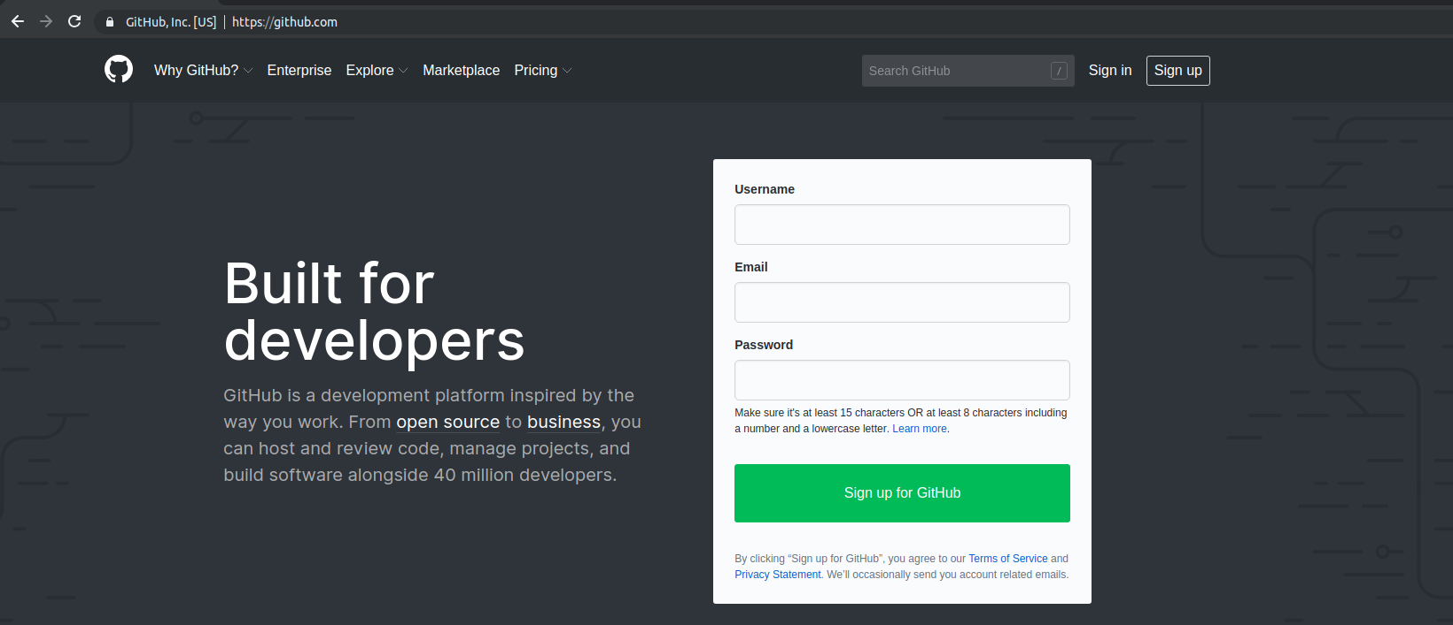
Create a GitHub user
Go to http://github.com and sign up for GitHub.

Slide 51
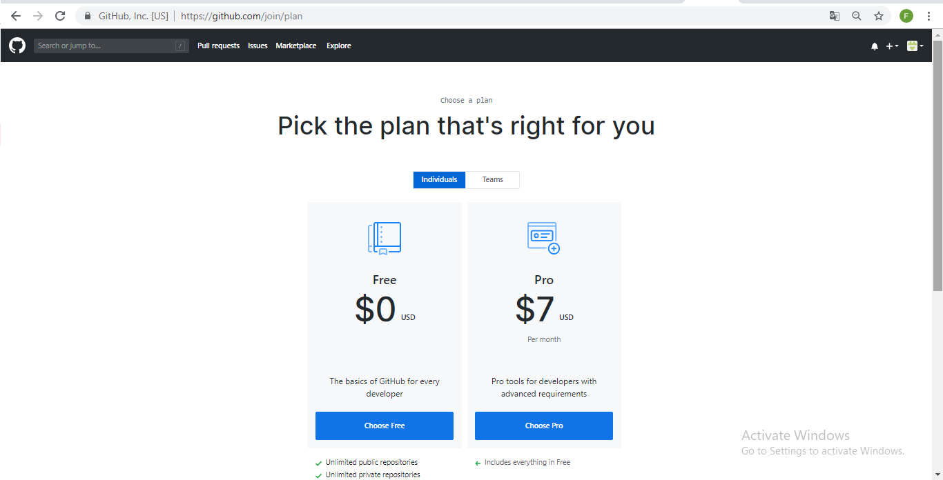
Create a GitHub user
Select the “Free” plan.

Slide 52
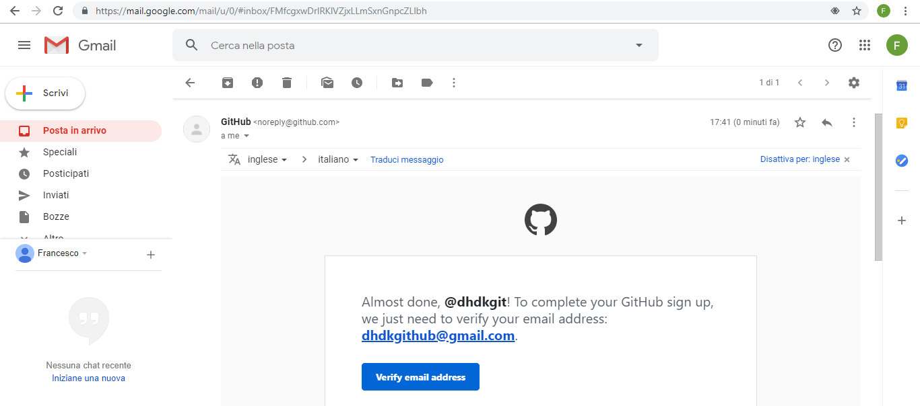
Create a GitHub user
Verify your email address.

Slide 53
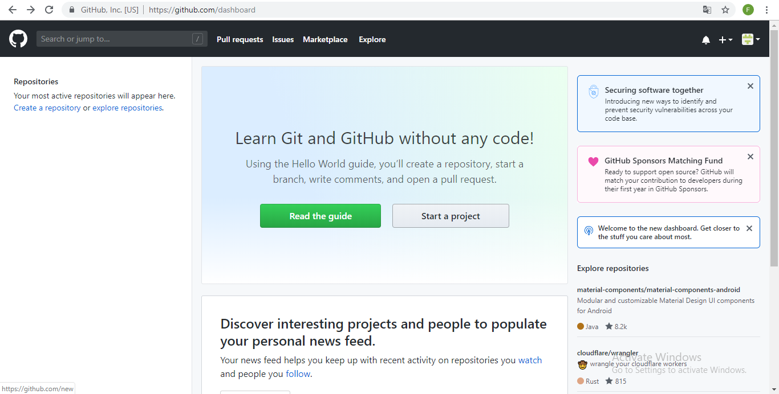
Create a GitHub user
Done!

Slide 54
Explore GitHub
your profile and repositories
search for a repository
inspect contributors’ activities
analyze commits and issues

Slide 55
Handson
Now you can start working to your project: a collaborative cookbook!
find your partners and break into groups of three/four
1 group = 1 cookbook
create a new GitHub repository for your cookbook
repository name should start with the prefix “cookbook-”, e.g. “cookbook-pasta”, “cookbook-italy”, “cookbook-bologna”, etc.

Slide 56
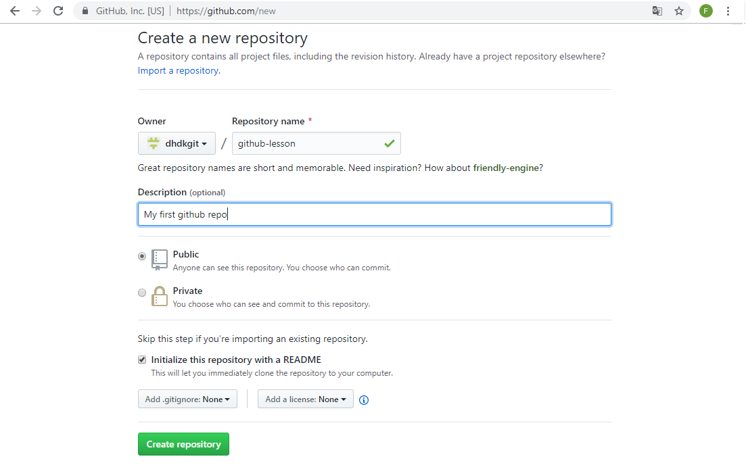
Create a new repository

Slide 57
The README file
The README file is used to describe your project, tell other people why it is useful, what they can do with it, and how they can use it.
A README is often the first item a visitor will see when visiting your repository.
If you put your README file in your repository's root, GitHub will recognize and automatically surface your README to repository visitors.

Slide 58
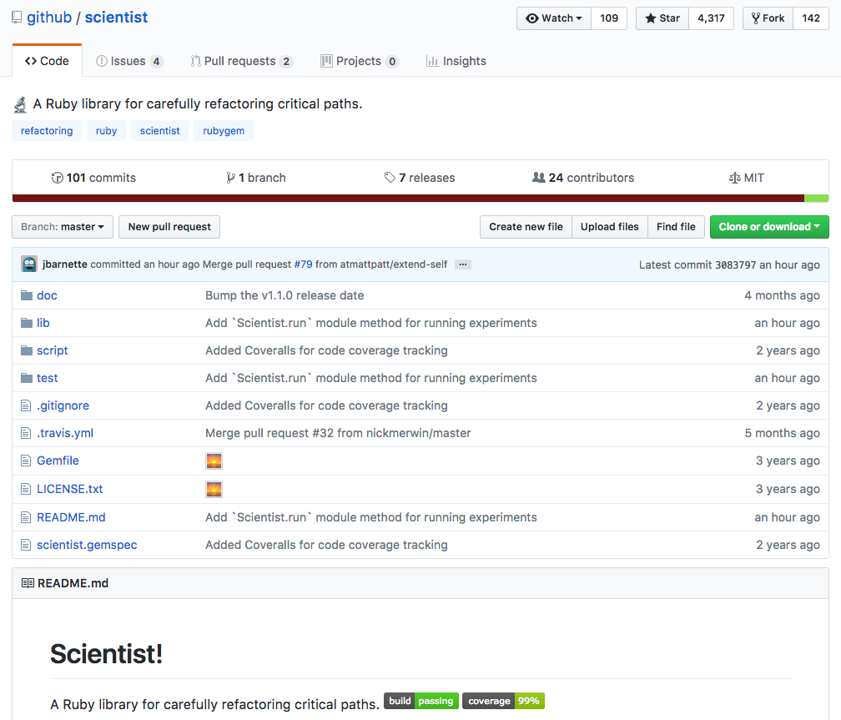
The README file

Slide 59
README file: Markdown
Markdown is a lightweight markup language with the goal of enabling people "to write using an easy-to-read and easy-to-write plain text format, and optionally convert it to structurally valid HTML".
You control the display of the document; formatting words as bold or italic, adding images, and creating lists are just a few of the things we can do with Markdown.
Mostly, Markdown is just regular text with a few non-alphabetic characters thrown in, like # or *.

Slide 60
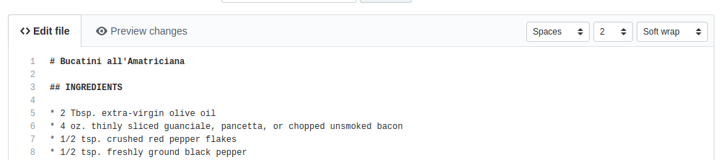
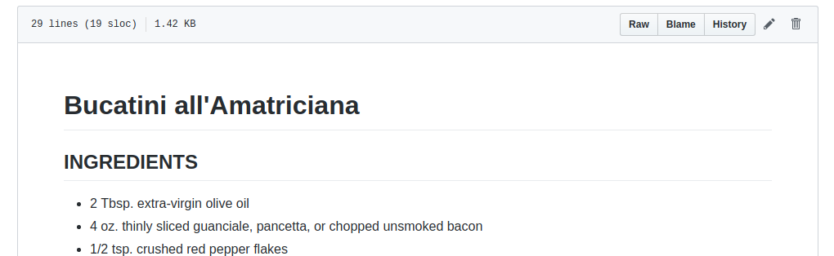
Markdown
Markdown
Markdown “converted” (i.e. HTML)

Slide 61
Exercise: the amatriciana recipe
Create a Markdown version of the amatriciana recipe (in your README.md file) - see:
https://docs.google.com/document/d/1HeuVC_jmxSRlFmBBh9KImPohmd6pYDqOl7-k6bRaUfs/edit?usp=sharing
GitHub guide - Mastering Markdown:
https://guides.github.com/features/mastering-markdown/

Slide 62
Handson
Step 1:
Invite collaborators (Settings → Collaborators)
Each group member should write at least 2 recipes (plain text or markdown - images are a plus).
Recipes should be organized in folders (e.g. First Course, Main Course, Side, Desserts, etc. - or Italian, German, French, English, etc.).

Slide 63
Handson
Step 2:
You should use issues tracking to organize your work (read the ‘Mastering Issues’ guide - https://guides.github.com/features/issues/):
Create at least 3 issues (put a title and a description - labels and assignees are optional)
reference other GitHub users using @mentions (at least 2 mentions in 2 issues)

Slide 64
Handson
Step 2:
connect the work being done with the bug being tracked using References (#) in your commit messages:
one of the more interesting ways to use GitHub Issues is to reference issues directly from commits. Include the issue number inside of the commit message.
by prefacing your commits with “Fixes”, “Fixed”, “Fix”, “Closes”, “Closed”, or “Close” when the commit is merged into master, it will also automatically close the issue.

Slide 65
Resources
https://git-scm.com/book/en/v2/
https://classroom.udacity.com/courses/ud775/
https://www.codecademy.com/learn/learn-git
https://guides.github.com/

Slide 66
Thanks for your attention!
Questions?

